Slide 1

E-COMMERCE FURNITURE SALES DATA ANALYSIS
Insights from the 2024 Furniture Dataset
Garima Shukla

Slide 2


OVERVIEW OF DATASET
DATASET
Total Entries: 1906
KEY METRICS
Price
Original Price
Unit Sold
Shipping Information
Tag Test
OBJECTIVE OF ANALYSIS
Derive Insight on sales prerformance
Customer preferences

Slide 3

DATA PREPROCESSING
HANDILING MISSING VALUES
Filled NULL values with 0
HANDLING DUPLICATE ROWS
Identified and removed 94 Duplicates
DATATYPE CONVERSIONS
Converted price to numeric value
Converted Original Price to Numeric Value

Slide 4

KEY METRIC OVERVIEW
PRODUCT SALES SUMMARY
46987 Total number of products sold
1906 Total number of unique products sold
SALES PERFORMANCE STATISTICS
24.45 Mean units sold
10000 is the maximum units sold for a product

Slide 5
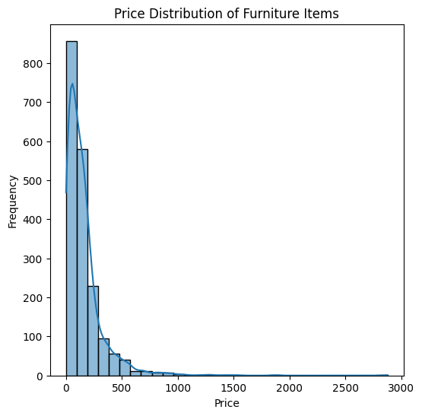
PRICE DISTRIBUTION
HISTOGRAM OF PRICE DISTRIBUTION
Skewed to the right, indicating most items are lower-priced
PRICE ESTIMATION TECHNIQUES
Kernel density estimation (KDE) curve provides a smoother estimate of the distribution.

Slide 6
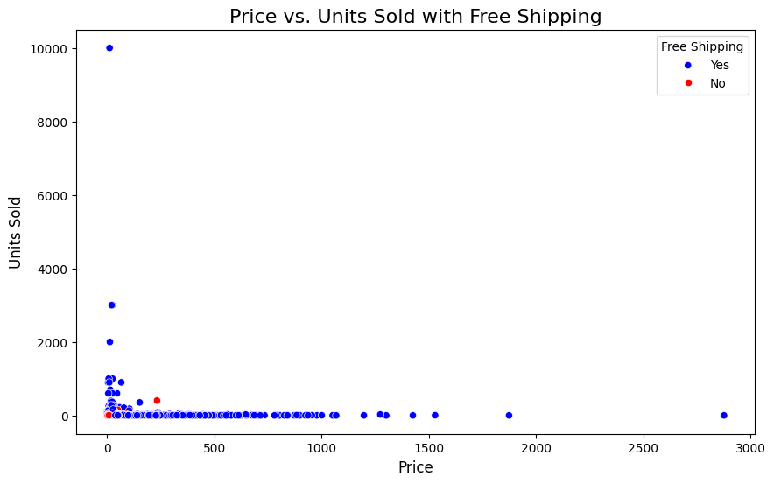
PRICE VS. UNITS SOLD
SCATTER PLOT ANALYSIS
Relationship between price and unit sold
Free shipping significantly increases units sold
NOTABLE TREND
Higher sale at lower sale price point with free shipping

Slide 7
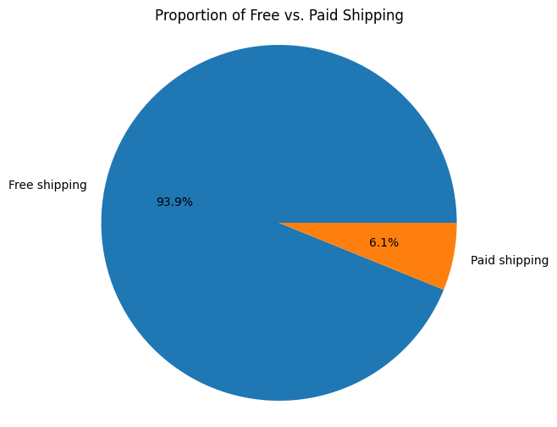
SHIPPING ANALYSIS
PROPORTION OF FREE VS. PAID SHIPPING
Majority of items are offered free shipping
NOTABLE TREND
free shipping is strong incentive for customer

Slide 8
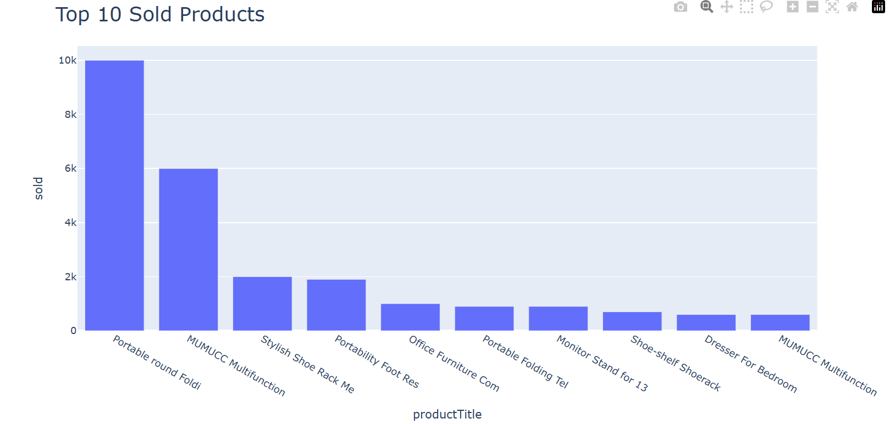
SALES ANALYSIS
TOTAL SALES REVENUE
TOP 10 SOLD PRODUCTS
Total Revenue: $2,110,806.88
Highlight: Portable Round Folding Table (10,000 units sold)
Revenue calculated as price multiplied by unit sold

Slide 9

DISCOUNT ANALYSIS
DISCOUNT CALCULATION
Calculated discount amount and percentage for each product
Average discount is 16.67 %

Slide 10

CONCLUSION
KEY TAKEAWAY
Free shipping is cruical for increasing sales
Lowered price items tends to sell better
Discount plays a significate role in customer purchasing decisions
RECOMMENDATIONS
Focus on free shipping offers
Analyze pricing strategies for higher sales

Slide 11

THANK YOU
E-commerce Furniture sales data analysis

